Slide 1
Example of UseCase

Slide 2
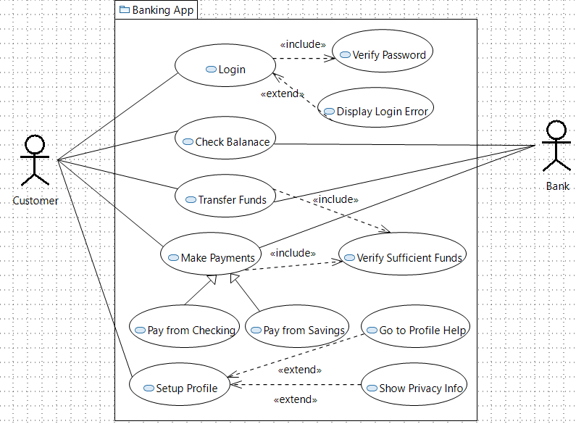
Use case Diagram – Example 1

Slide 3
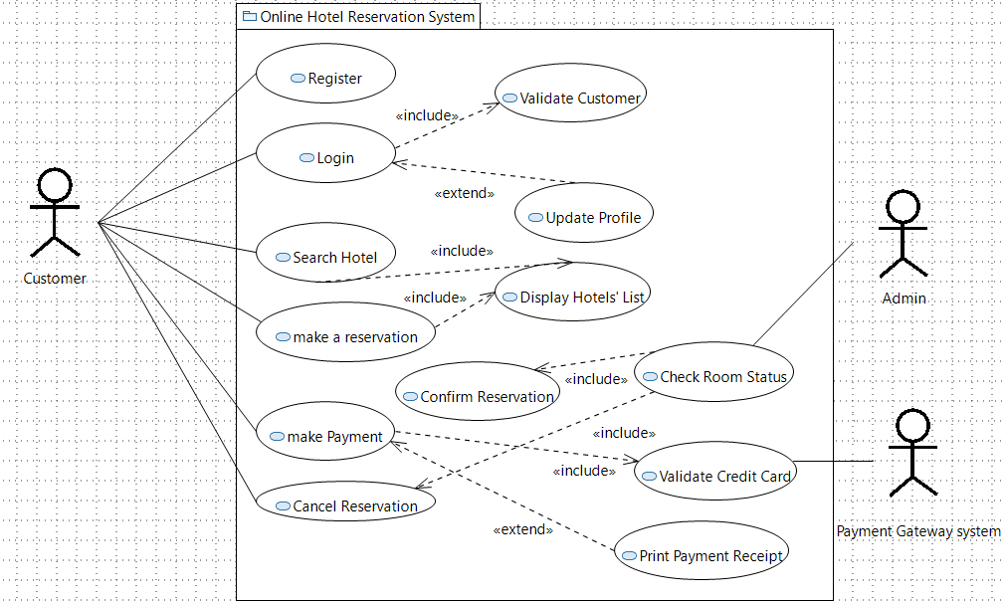
Use case Diagram – Example 2

